Slide 1
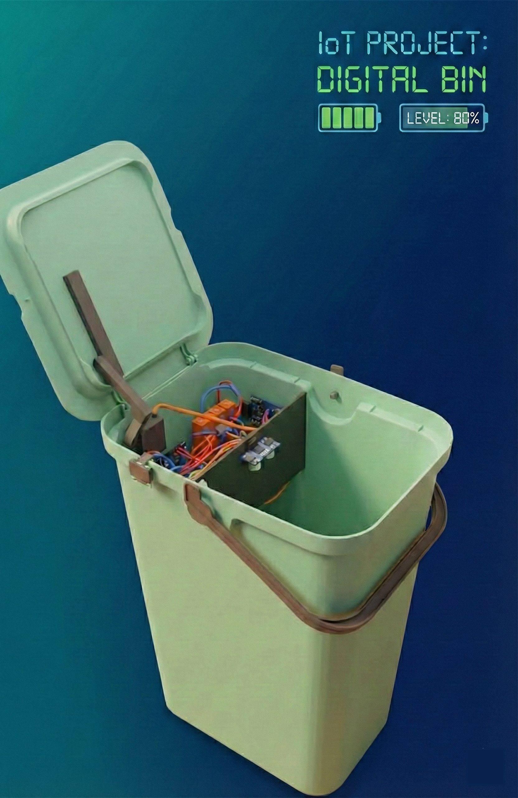
DigitalBin
Simone aresta
francesco pietri
Notes:
Francesco

Slide 2
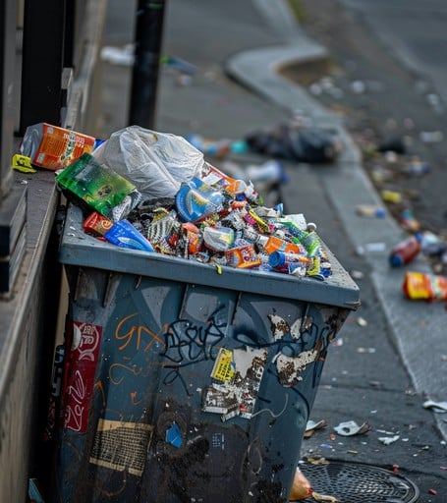
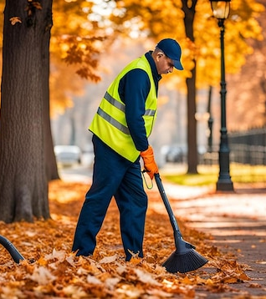
Main Goals
Urban and rural upkeep
Preventing bin overflows
Enhanced schedule of waste collectors
Enhance maintenance interventions
Notes:
Francesco

Slide 3



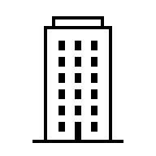
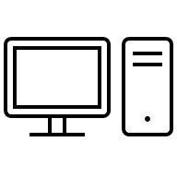
Infrastructure Overview
10km
HiveMQ public
MQTT Broker
Public Thingsboard CE instance
Central Controller
Notes:
Francesco

Slide 4
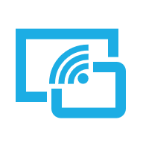
1. Digital Bin
The Digital Bin sends
Once, its geographical coordinates (lat and lon)
It periodically sends the fill level and overturn status (yes/no)
Notes:
Simone

Slide 5
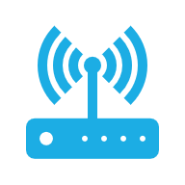
2. Receiver LoRa + Bridge
Receiver LoRa receives data from the Digital Bins in the area and send them to the Bridge
Bridge forwards the data on a MQTT Server and takes the data from it
Notes:
Simone

Slide 6
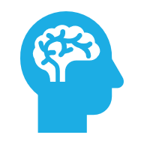
3. Central Controller
It is the brain of the project. It is responsible for processing the data.
It communicates when to close the bins
It notifies when the bins are overturned
If a bin is closed, it calculates the distance to the nearest free bin.
It sends the updates to the web dashboard
Notes:
Simone

Slide 7
4. Web Dashboard
It exploits ThingsBoard CE
It shows map on where the bins are located
It shows fill level of each bin
It shows a chart displaying the fill level of each bin over time
You can ask to a ML Model the fill level of a bin in the future
Notes:
Simone

Slide 8

Digital Bin In Depth
Notes:
Francesco

Slide 9
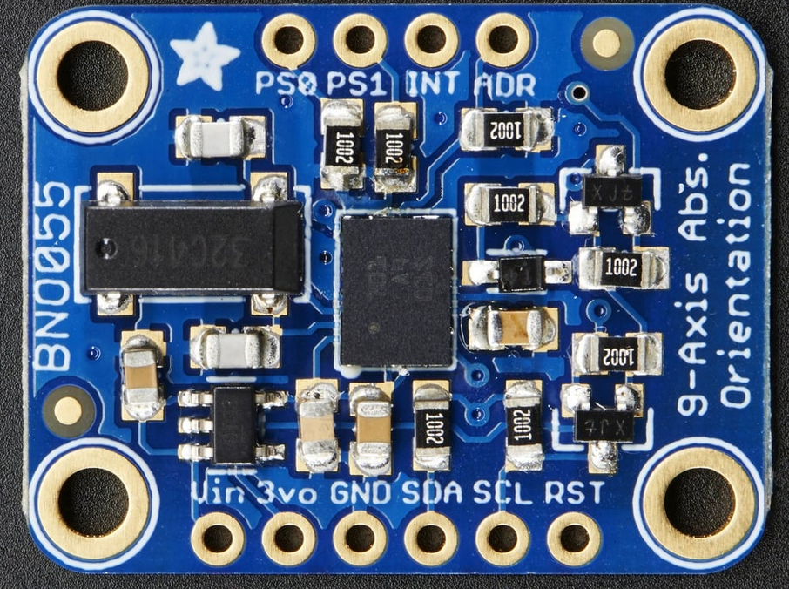
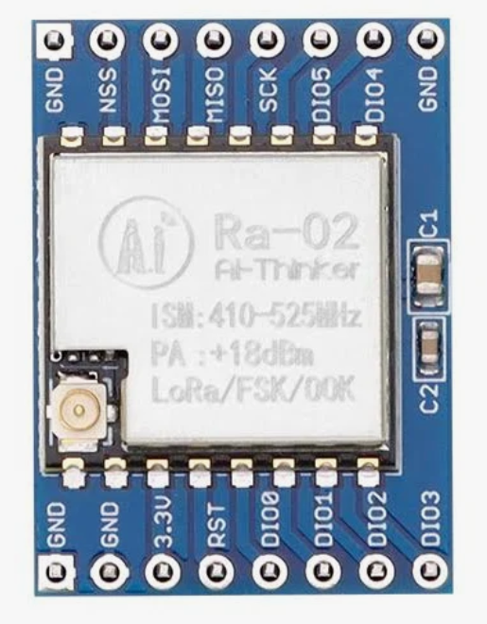
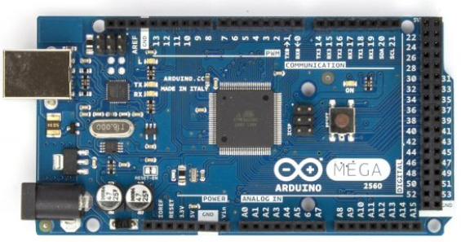
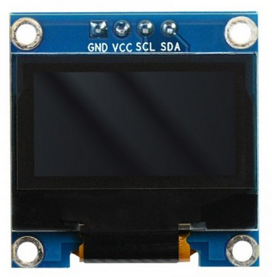
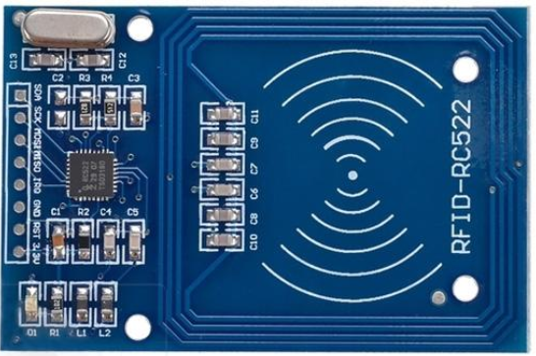
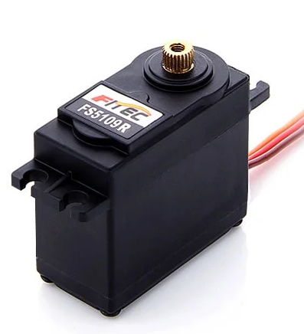
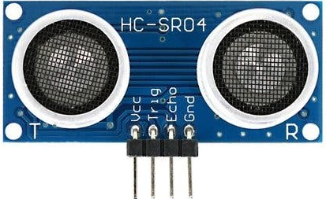
DigitalBin – Onboard Hardware
Magnetometer, Accelerometer,
Gyroscope
LoRa radio
transmitter
Microcontroller
BMO055
SX1278
NFC card reader
Display
SSD1306
RFID - RC522
STD Servo motor
Ultrasonic
sensor
Arduino Mega 2560​
HC-SR04
Notes:
Francesco

Slide 10
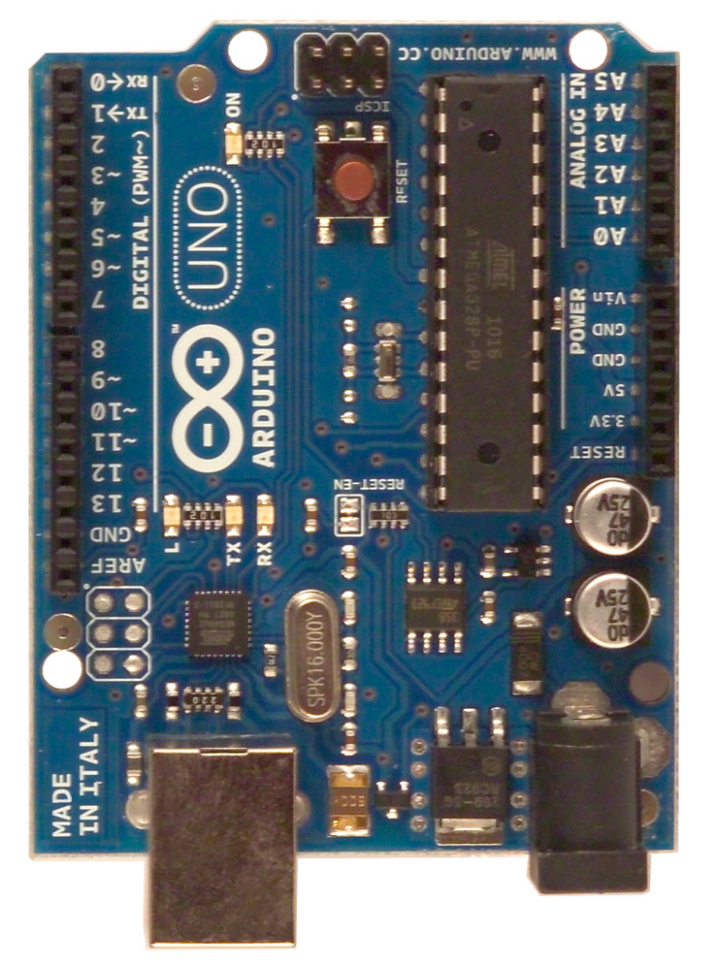
DigitalBin – Receiver Hardware
Microcontroller
LoRa radio
transmitter
Bridge Computer
SX1278
Arduino Uno
Notes:
Francesco

Slide 11
DigitalBin - LoRa Technology
LoRa (Long Range) is a radio modulation technique used to create long-range (5-10 km) communication links.
The communication is Broadcast (433 Mhz)
It’s designed for low power usage and low bandwidth (sending small data packets)
For the project, LoRa is used to connect more digital bins with a central receiver. Each digital bin sends data of its sensors to the receiver, and the receiver sends the information of what to do (created by Central Controller) to each digital bin.
Notes:
Francesco

Slide 12
DigitalBin – Packet (Bin → Bridge)
START_SEQ
POSITION/FILL/OVERTURN
ID
PAYLOAD
Position → lat,lon
Fill → fill_level (%)
Overturn → is_Overturn (true/false)
PAYLOAD
Notes:
Simone

Slide 13
DigitalBin – Packet (Bridge → Bin)
START_SEQ
MY_ADDRESS
START_MARKER
0xFE
CMD
PAYLOAD
END_MARKER
0xFF
FSM
CMD
CMD_LOCK
CMD_LCD
Notes:
Simone

Slide 14
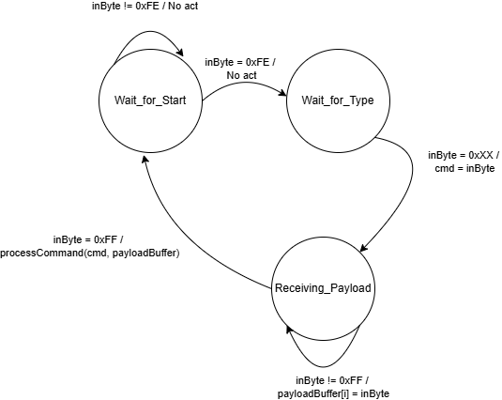
DigitalBin - Finite State Machine
FSM - Mealy
Notes:
Simone

Slide 15
Receiver LoRa
The goal of this component is to connect the Digital Bins with the Bridge.
Bin → Bridge: it listens via LoRa. When it receives the packet, it forwards that on the Bridge
Bridge → Bin: it listens via Serial. When it receives the packet (0xFE … 0xFF), it packs that, inserting the start_seq and the address of destination digital_bin
Notes:
Francesco

Slide 16
Receiver LoRa - Acknowledgment
Receiver LoRa
Digital Bin
Create Packet
Compute CRC
Waiting
For Ack
Receive Packet
Compute CRC
Send it as ACK
Compare CRC
If Equal ✔
Otherwise send again
(3 times max)
Notes:
Francesco

Slide 17
Bridge
The Bridge has the role to connect the Digital Bins to the digital real world. In particular it converts the data from Serial (used to communicate with Receiver LoRa) to MQTT (TCP/IP) (used to communicate with HiveMQ) and viceversa
The Bridge is Publisher for
/Bins/Bin_id/fill
/Bins/Bin_id/overturn
/Bins/Bin_id/position
The Bridge is Subscriber for
/Bins/Bin_id/lock
/Bins/Bin_id/lcd
Notes:
Francesco

Slide 18
HiveMQ
HiveMQ is a fully managed MQTT Cloud Platform that aim to create reliable, scalable and secure MQTT cloud-broker clusters that are built for production. The free tier allows to connect up to 100 devices and gives 10Gb of MQTT traffic each month.
In our architecture we use it to transfer data from periferal bin to the central controller.
Notes:
Francesco

Slide 19
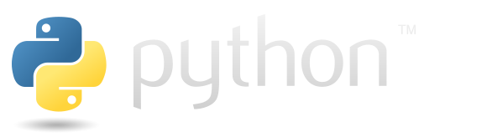

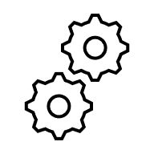
Central Controller
The Controller decide:
When to close the lid
Compute the direction and distance of the next free bin
Predictive modeling of bin saturation based on past collection cycles.
Subscribe to:
Fill
Overturn
Position
Data is stored in Json files and dictionaries
Upload data to a ThingsBoard dashboard for visualization.
Publish on:
Lock
lcd
Notes:
Francesco

Slide 20

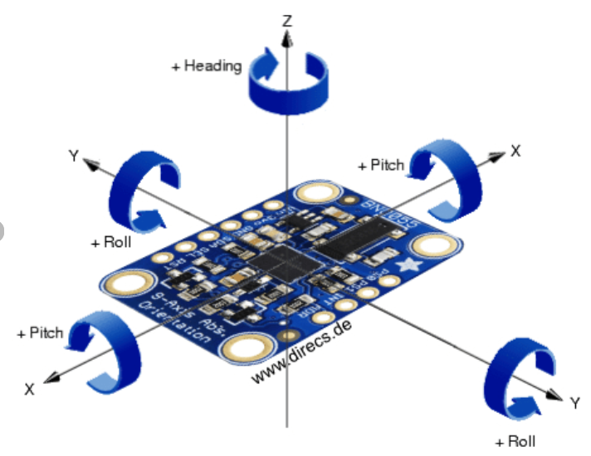

Central Controller - Next open bin detection
The controller checks for the presence of other bins within a 1km radius. If multiple bins are detected, it selects the nearest one.
The new bin must be open.
Utilizing an onboard sensconsisting of a magnetometer, accelerometer, and gyroscope, the bin maintains full 3D orientation awareness. This enables the system to perform dynamic heading compensation, ensuring the directional arrow remains accurate even when the device is rotated
1km
Notes:
Francesco

Slide 21
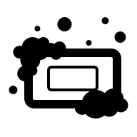
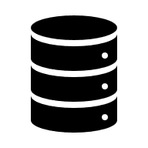
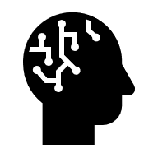

Central Controller - ML Predictor Pipeline
Cleaning Data:
Outliers detection
Missing value
Features exctractor
Cyclical Encoding
Storage Data
Json file
Train Model
Prediction
Takes Data
Notes:
Simone

Slide 22
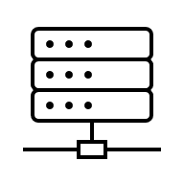

Thingsboard
Thingsboard is an open-source IoT (Internet of Things) platform designed for data collection, processing, visualization, and device management.
In particular we use it in our project as an interactive dashboard that waste collectors can use to check the bin state and location.
MQTT Protocol
Central Controller
Self-hosted thingsboard instance
Data is sent to a gateway via the MQTT protocol. The gateway is responsible for dynamically provisioning new devices and forwarding the relevant telemetry to them. This data is then used to generate real-time graphs and visualizations within the dashboard
Notes:
Francesco

Slide 23

Waste Collector - Interactions
The Waste Collector can interact with the system by the
Web Dashboard (ThingsBoard)
NFC Module
Notes:
Simone

Slide 24
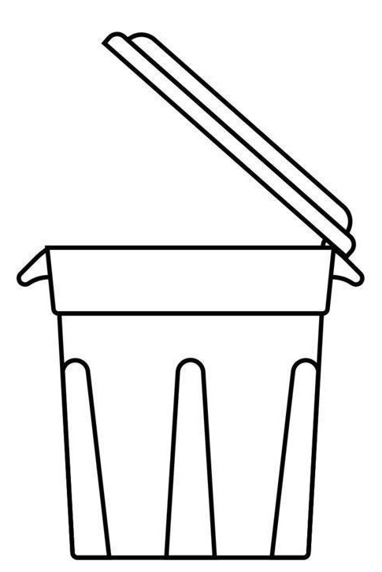
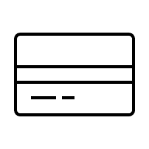
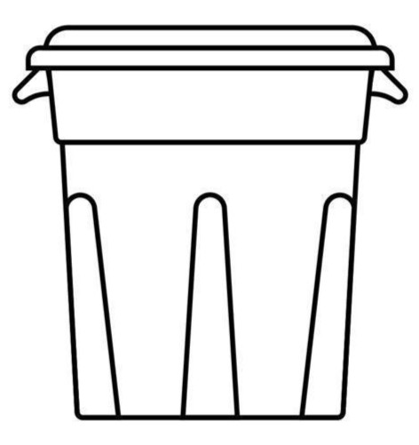


Waste Collector - NFC
The NFC Module allows authorized personal to open a full bin to empty it.
, Enter configuration mode
Emptying
Exit configuration mode
Notes:
Simone

Slide 25
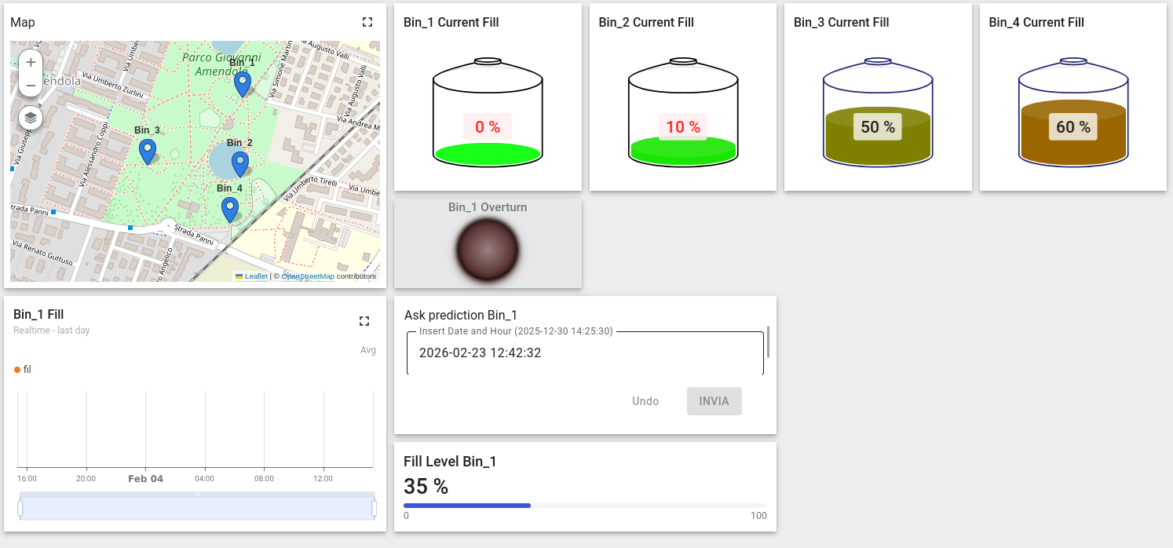
Waste Collector - Dashboard
Each waste collector has a customer account within Thingsboard
Notes:
Francesco

Slide 26
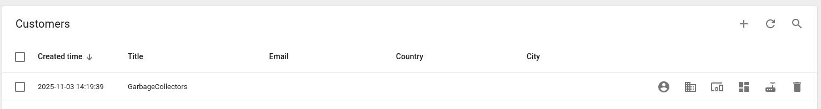
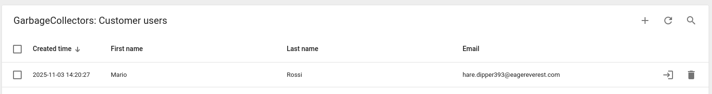
Waste Collector - Dashboard
Administrators centrally manage collectors by assigning specific assets and dashboards. This regulates access and permissions, significantly enhancing security through organized emploee management
Notes:
Francesco

Slide 27
Pro and Cons
Pro:
Cheap hardware and installation
Low consumption and long range thanks to LoRa
Software easy to extend thanks to the modular approch
Software easy to develop thanks to python
No need for subscription plan to external service
Easy and centralized emploee management
Cons:
Might need to upgrade HiveMQ plan for higher trasmission limits
Low responsivness due LoRa regulation , teoretically 1 trasmission every 3/4 mins
Notes:
Francesco

Slide 28

Future developments
Notes:
Simone

Slide 29
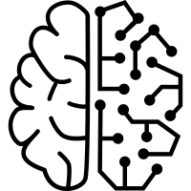
Future Developments
Enhance the hardware by implementing an IP-rated waterproof enclosure, a rain-activated automatic closure system, and an integrated GPS module for precise geolocation.
Integrate a real Machine Learning model such as Prophet or Random Forest
Notes:
Simone

Slide 30

Future Developments
Improve waste collector schedule and route based on distance and forecasting prediction
Upgrade the dashboard to enable waste collectors to report specific maintenance or operational problems
Notes:
Simone

Slide 31
Thanks for your attention
By Francesco Pietri, Simone Aresta

